Slide 1

Malignant Comments Classifier Project
Malignant Comments Classifier Project
Presented by
ABHISHEK MITTAL

Slide 2
TABLE OF CONTENTS
Introduction
Problem Statement
Conceptual Background of the Domain Problem
Motivation for the Problem
Hardware and Software Requirements and Tools UsedAbout The DataSet
Data Analysis and Model Building Flowchart
Data Sources and their formats
About The DataSet
All Data Preprocessing step details
Imported Library and class
Describing Count plot of each column
Words Frequent of each column
barPlot of total no of messages in each column
Correlation using heatmap
Model building
Model performence
Parameter tuning
Interpretation of the Results
Future work
Conclussion

Slide 3
Introduction
In this project, we have been provided with two datasets namely train and test CSV files. We will build a machine learning model by using NLP using a training dataset. And using this model we will make predictions for our test dataset.
We will need to build multiple classification machines and learning models. Before model building, we will need to perform all data pre-processing steps involving NLP. After trying different classification models with different hyperparameters than will select the best model out of them. We will need to follow the complete life cycle of data science that includes steps like - 1. Data Cleaning
2. Exploratory Data Analysis
3. Data Pre-processing
4. Model Building
5. Model Evaluation
6. Selecting the best model
Finally, we compared the results of proposed and baseline features with other machine learning algorithms. The findings of the comparison indicate the significance of the proposed features in cyberbullying detection.

Slide 4
Problem Statement
The proliferation of social media enables people to express their opinions widely online. However, at the same time, this has resulted in the emergence of conflict and hate, making online environments uninviting for users. Although researchers have found that hate is a problem across multiple platforms, there is a lack of models for online hate detection.
Online hate, described as abusive language, aggression, cyberbullying, hatefulness and many others has been identified as a major threat on online social media platforms. Social media platforms are the most prominent grounds for such toxic behaviour.
There has been a remarkable increase in the cases of cyberbullying and trolls on various social media platforms. Many celebrities and influences are facing backlashes from people and have to come across hateful and offensive comments. This can take a toll on anyone and affect them mentally leading to depression, mental illness, self-hatred and suicidal thoughts.
Internet comments are bastions of hatred and vitriol. While online anonymity has provided a new outlet for aggression and hate speech, machine learning can be used to fight it. The problem we sought to solve was the tagging of internet comments that are aggressive towards other users. This means that insults to third parties such as celebrities will be tagged as unoffensive, but “u are an idiot” is clearly offensive.
Our goal is to build a prototype of online hate and abuse comment classifier which can used to classify hate and offensive comments so that it can be controlled and restricted from spreading hatred and cyberbullying.

Slide 5
Conceptual Background of the Domain Problem
Internet comments are bastions of hatred and vitriol. While online anonymity has provided a new outlet for aggression and hate speech, machine learning can be used to fight it. The problem we sought to solve was the tagging of internet comments that are aggressive towards other users. This means that insults to third parties such as celebrities will be tagged as un-offensive, but “u are an idiot” is clearly offensive.

Slide 6
Motivation for the Problem
The project was the first provided to me by FlipRobo as a part of the internship programme. The exposure to real world data and the opportunity to deploy my skillset in solving a real time problem has been the primary objective. However, the motivation for taking this project was that it is relatively a new field of research. Here we have many options but less concrete solutions. The main motivation is to build a prototype of online hate and abuse comment classifier which can used to classify hate and offensive comments so that it can be controlled and restricted from spreading hatred and cyberbullying.

Slide 7
Hardware and Software Requirements and Tools Used
Hardware:- Desktop/Laptop
Software:- Anaconda

Slide 8
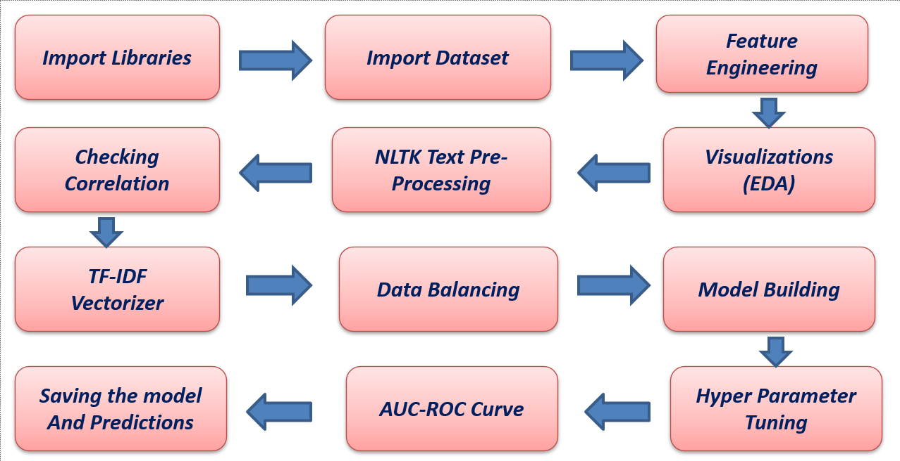
Data Analysis and Model Building Flowchart

Slide 9
Data Sources and their formats
The data was provided by FlipRobo in CSV format. After loading the training dataset into Jupyter Notebook using Pandas and it can be seen that there are eight columns named as:
“ id, comment_text, “malignant, highly_malignant, rude, threat, abuse, loathe”.
There are 8 columns in the dataset provided:
The description of each of the column is given below:
- Malignant: It is the Label column, which includes values 0 and 1, denoting if the comment is malignant or not.
- Highly Malignant: It denotes comments that are highly malignant and hurtful.
- Rude: It denotes comments that are very rude and offensive.
- Threat: It contains indication of the comments that are giving any threat to someone.
- Abuse: It is for comments that are abusive in nature.
- Loathe: It describes the comments which are hateful and loathing in nature.
- ID: It includes unique Ids associated with each comment text given.
- Comment text: This column contains the comments extracted from various social media platforms

Slide 10
About The DataSet
Variable | Definition
id | A unique id aligned with each comment text.
comment_text | It includes the comment text.
malignant | It is a column with binary values depicting which comments are malignant in nature.
highly_malignant | Binary column with labels for highly malignant text.
rude | Binary column with labels for comments that are rude in nature.
threat | Binary column with labels for threatening context in the comments.
abuse | Binary column with labels with abusive behaviour.
loathe | Label to comments that are full of loathe and hatred.

Slide 11
Data Preprocessing
For the purpose of the project the dataset has been preprocessed as follows:
Importing necessary libraries and importing dataset as a data frame.
Checked some statistical information like shape, number of unique values present, info, finding more values etc.
Checked for null values and did not find any null values and removed Id.
Done feature engineering and created new columns viz label which contain both good and bad comments which is the sum of all the labels, comment length which contains the length of comment text.
Visualized each feature using seaborn and matplotlib libraries by plotting categorical plots like pie plot , count plot, distribution plot and wordcloud for each label.
Done text pre-processing techniques like Removing Punctuations and other special charactors. Splitting the comments into individual words. Removing Stop Words. Stemming and Lemmatization. Then created new column as clean, length after cleaning the data. All these steps were done on both train and test datasets. Checked correlation using heatmap. After getting a cleaned data used TF-IDF vectorizer.

Slide 12
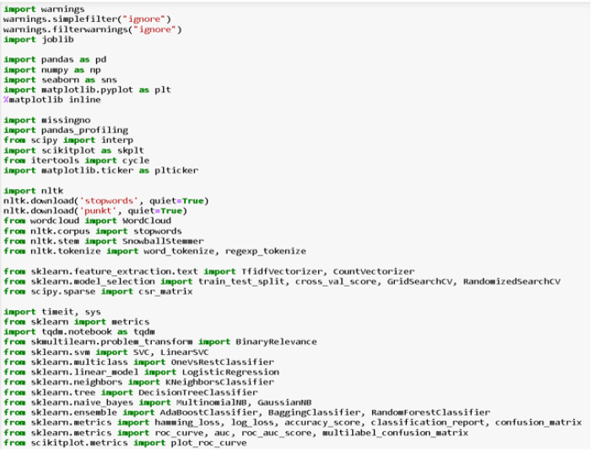
Imported Library and class

Slide 13
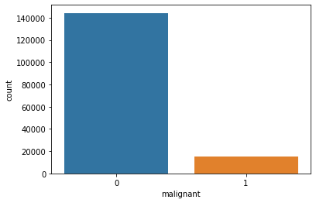
Count plot of Malignat column and describe
Here in the first graph of malignant we can clearly observe that most of the messages are not malignant.

Slide 14
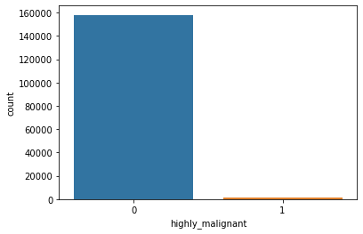
Count plot of highly-Malignat column and describe
In the second image we can clearly observe that there are very less highly malignant messages.

Slide 15
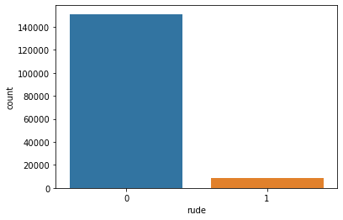
Count plot of Rude column and describe
Same in third picture there are few rude comments in the dataset.

Slide 16
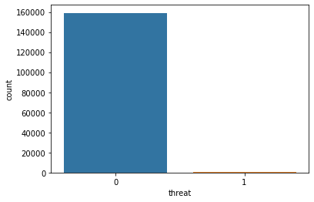
Count plot of threat column and describe
In 4th we can clearly see that there are very few cases/almost negligible of threat comments

Slide 17
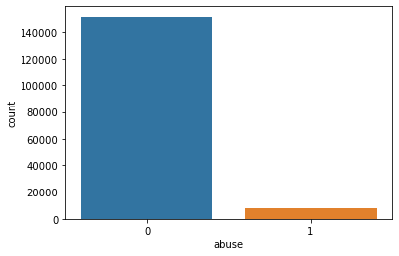
Count plot of abuse column and describe
In 5th image we can clearly see that there are some messages with abusive language.

Slide 18

Count plot of loath column and describe
While in the sixth image we can clearly see that there are very few cases of loathe messages

Slide 19
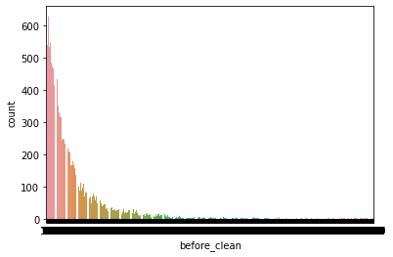
Count plot of before_clean column and describe
In 7th image we can see the no. of words in each rows

Slide 20
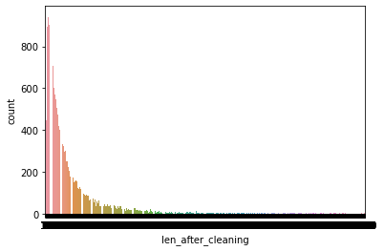
Count plot of len_after_clean column and describe
In 8th image we can see the cleaned no. of remaining words in each row.

Slide 21
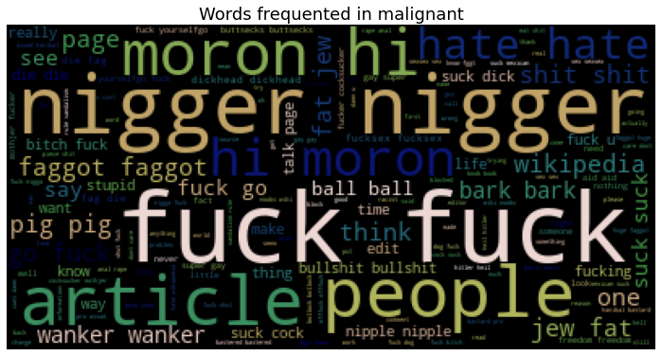
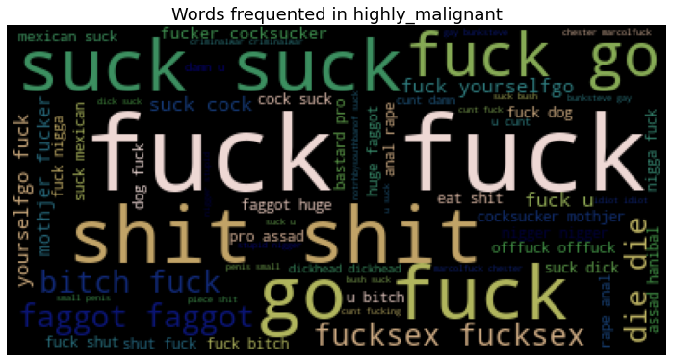
Words Frequent in malignant and high malignant

Slide 22
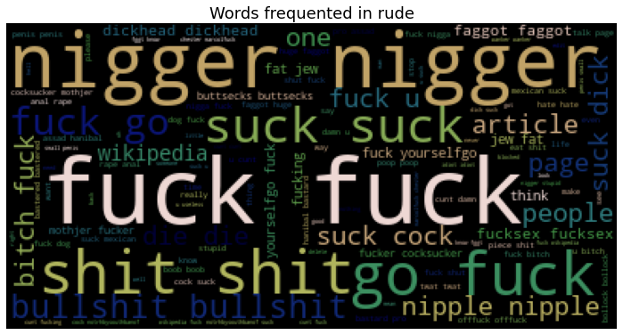
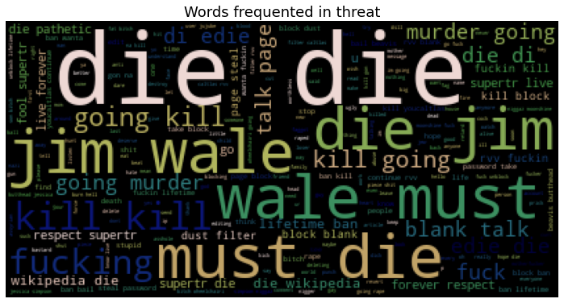
Words Frequent in rude and high threat

Slide 23
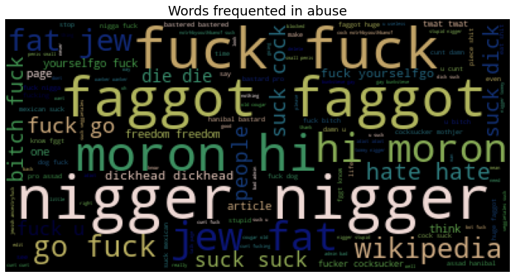
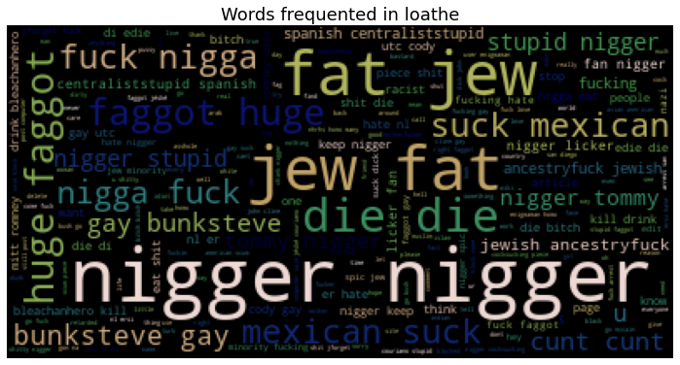
Words Frequent in abuse and high loathe

Slide 24
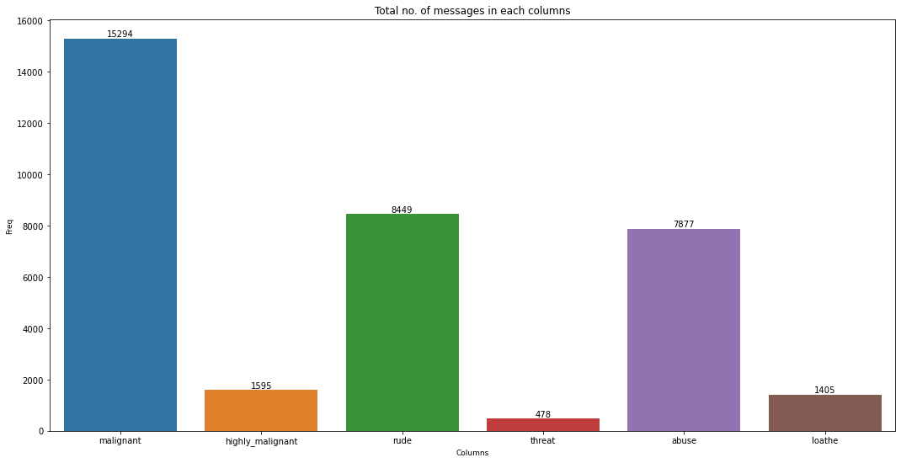
barPlot of total no of messages in each column

Slide 25
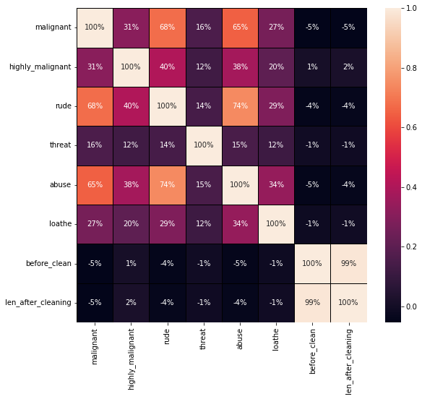
Correlation using heatmap

Slide 26
Model Building
In this project there were 6 features which defines the type of comment like malignant, hate, abuse, threat, loathe but we created another feature named as “label” which is combined of all the above features and contains the labelled data into the format of 0 and 1 where 0 represent “NO” and 1 represents “Yes” . In this NLP based project we need to predict the multiple labels which are binary. I have converted text into feature vectors using TF-IDF vectorizer and separated our feature and labels. Also, before building the model, I made sure that the input data is cleaned and scaled before it was fed into the machine learning models.
After the pre-processing and data cleaning I used remaining independent features for model building and prediction. The classification algorithms used on training the data are as follows.
1. Logistic Regression
2. MultinomialNB
3. LineraSVC
4. Gradient Boosting Classifier
5. Decision Tree Classifier
6. Ada Boost Classifier

Slide 27
MODEL PERFORMENCE
classifier: LinearSVC
Jaccard score: 0.8478403520284093
Accuracy score: 0.9176554144385026
f1_score: 0.9176554144385026
Precision : 0.9176554144385026
Recall: 0.9176554144385026
Hamming loss: 0.08234458556149733
classifier: LogisticRegression
Jaccard score: 0.8443875093910732
Accuracy score: 0.9156291778074866
f1_score: 0.9156291778074866
Precision : 0.9156291778074866
Recall: 0.9156291778074866
Hamming loss: 0.08437082219251336
classifier: MultinomialNB
Jaccard score: 0.8337546924078756
Accuracy score: 0.9093415775401069
f1_score: 0.9093415775401069
Precision : 0.9093415775401069
Recall: 0.9093415775401069
Hamming loss: 0.09065842245989304
classifier: SGDClassifier
Jaccard score: 0.8368858277535829
Accuracy score: 0.9112007018716578
f1_score: 0.9112007018716578
Precision : 0.9112007018716578
Recall: 0.9112007018716578
Hamming loss: 0.08879929812834225
classifier: LGBMClassifier
Jaccard score: 0.8471630042636931
Accuracy score: 0.9172585227272727
f1_score: 0.9172585227272727
Precision : 0.9172585227272727
Recall: 0.9172585227272727
Hamming loss: 0.08274147727272728
classifier: RandomForestClassifier
Jaccard score: 0.8460589233379608
Accuracy score: 0.9166109625668449
f1_score: 0.9166109625668449
Precision : 0.9166109625668449
Recall: 0.9166109625668449
Hamming loss: 0.08338903743315508

Slide 28
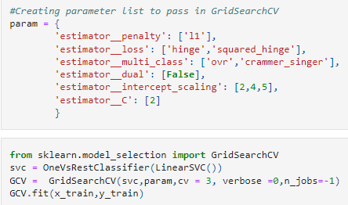
Hyper parameter Tuning
I have used 6 LinearSVC classifier parameters to be saved under the variable "parameters" that will be used in GridSearchCV for finding the best output. Assigned a variable to the GridSearchCV function after entering all the necessary inputs. And we used our training data set to make the GridSearchCV aware of all the hyper parameters that needs to be applied on our best model

Slide 29
Interpretation of the Results
LinearSVM and Random Forest models perform best in this project
At first we get only 91.76% accuracy from LinearSVM But after parameter tuning we get 91.77% accuracy.There is no defference in accuracy score after parameter tuning.
Using hyper parameter tunning we can improve our model accuracy, But here in this model the accuracy did not increased.
It is always advised to all of us that atleast we need to use 5 Algorithm in order to figure out which one is performing best among them and we choose that one and we send that for hyper parameter tuning to know that best parameter .

Slide 30
Future Work
For future improvements, following step we thought to took-
Replacing model with a latest/different model
Using other robust datasets
Predicting result on differents attributes
It would seem that better performance might be achieved if multiple learners were combined.

Slide 31
Conclussion
When I was working on this project, many complications were involved. There are many variables / attributes to consider in determining our target value, we need a lot of calculating power to get near 100% accuracy result . And it is very difficult to accurately predict any comment good or bad.
For any of machine learning project my suggestion is first you have to understand the problem on ground level .if you don’t allow yourself to work with diligence .if you don’ t work harder anything that you are doing or will do , not only in case of machine learning but also in life cycle would be futile. Maybe, my endeavour assist you when ever you will get stuck

Slide 32

THANK YOU

